Slide 1
Department of Computer Science
GeoFriend
Exploratory Analysis of Geolocational Data
First phase presentation
Group 5
Ansar P A
Ayisha Ban
Jins Mathew Koshy
Muhammed Nazarudheen
Carried out under the guidance of
Sharija PM

Slide 2
Presentation Outline
Abstract
Introduction
Scope of project
System Requirement
Software Requirement
Hardware Requirement
Purpose of project
Implementation
Architecture Design
State Diagram
Software Process Model
Methodology
Use Case
Data Flow Diagram
User Interface and Database
Code Synopsis
Advantages
Conclusion

Slide 3
Abstract
This project involves the use of KNN (K Nearest Neighbour) algorithm and GPS (Global Positioning System) technology to find the best locations for people to eat and relax in any new city on the basis of their preferences, amenities, budget and proximity to the location.

Slide 4
Introduction
Use of Global Positioning System (GPS).
GeoFriend is a website that will provide appropriate insights about the city based on the user preferences.
The usage of KNN algorithm for classifying plotted data.
User Validation via username and password.
Special control for administrator to manipulate database.

Slide 5
Scope of the Project
Presences of ample amount of individual products that mimic certain features of our product.
Our product bring integration to the currently existing systems..
Our product will overcome the difficulties on the currently existing system.
Make the life of users much more easier.

Slide 6
System Requirement
User have to view all the preferred locations near their facility.
The preferred locational data from user is further classified into different classes.
The user can view details of the preferred facility.
Administrator can manipulate the category and its details in the database.
System shall provide authentication to avoid unauthorized access.

Slide 7
Software Requirements
→XAMPP
→Anaconda
→VS Code
→LucidChart
Hardware Requirements
The minimum hardware requirements:
CPU: 2 x 64-bit 2.8 GHz 8.00 GT/s CPUs.
RAM: 8 GB or 4 GB of 1600 MHz DDR4 RAM.
Storage: 150GB of free memory space.

Slide 8
Purpose of the Project
The main purpose of the project is to make life of the user easier through proper utilization of the currently existing GPS technology,and providing confidence to pupils, like students for moving out to a new city and achieve their dreams.

Slide 9
Implementation
Our website is the main and the only user interacting system in the product.
The website will be used by the consumers for getting details about the available facilities near their location.
The website is design with bootstrap templates which involves HTML,JS,CSS.
The folium package is used to plot points on basis of coordinates.
The KNN algorithm is used to predict classes of the facility.
The PHP code control the flow of data to the database.

Slide 10
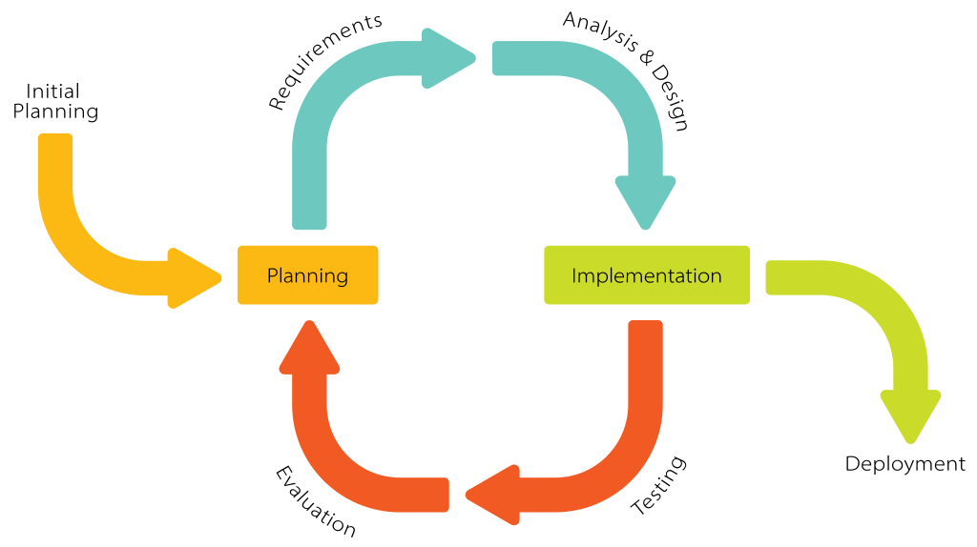
Software Process Model used: Iterative model

Slide 11
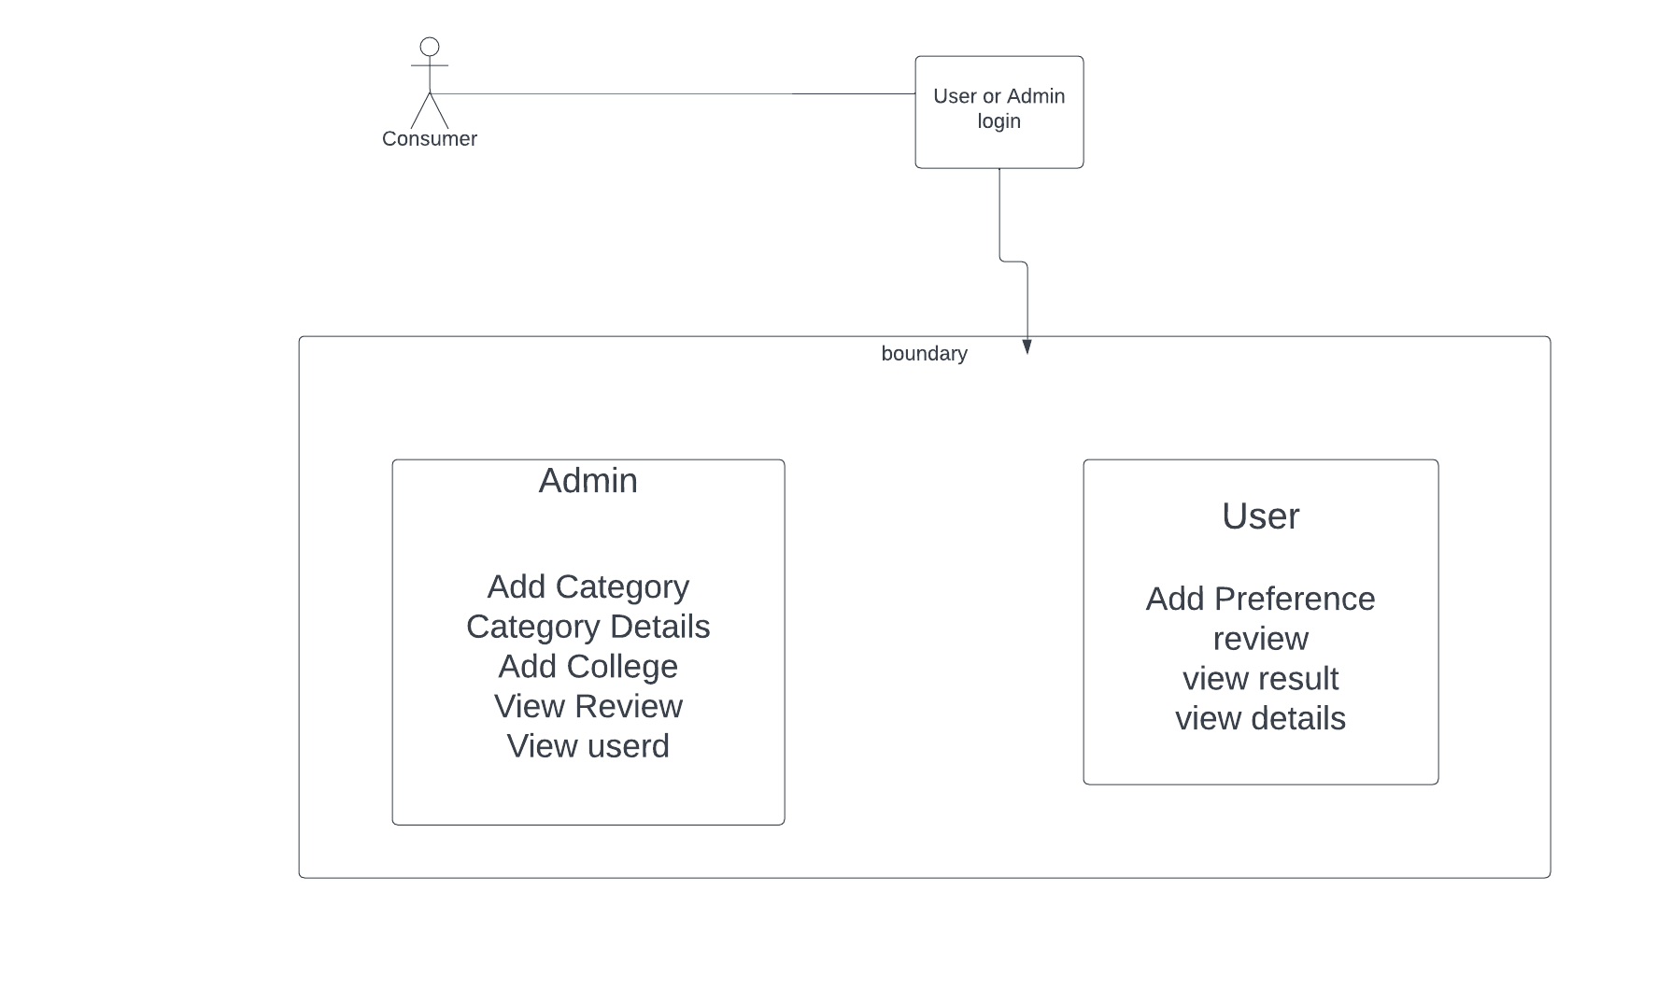
Architecture Design

Slide 12
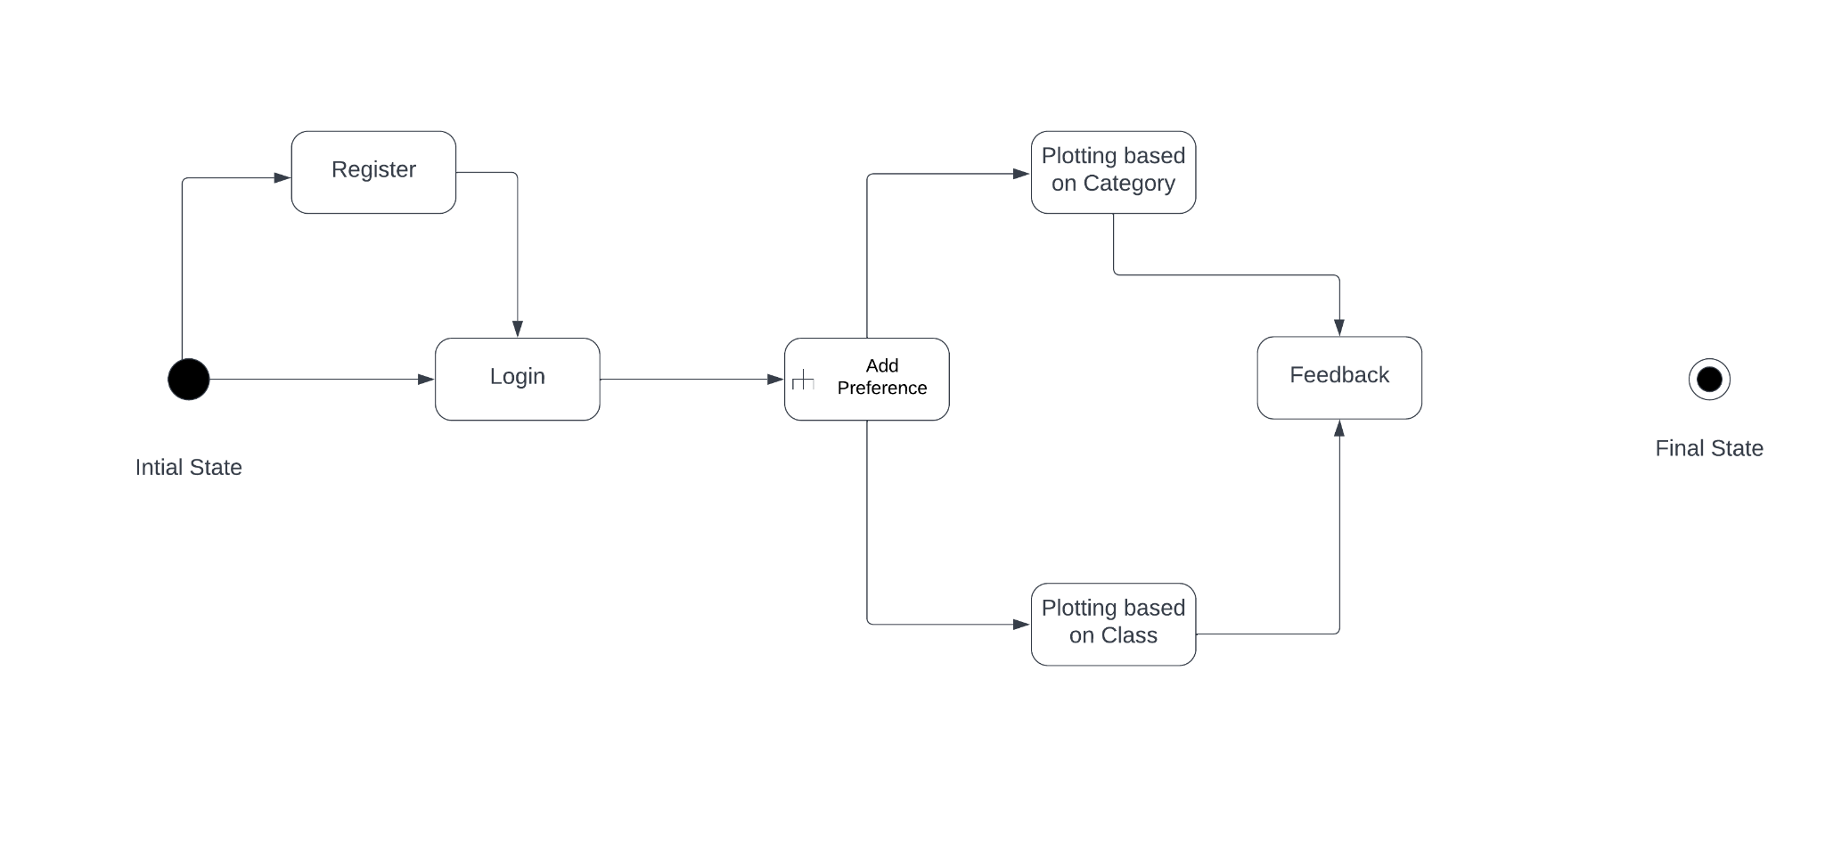
State Diagram
For User

Slide 13
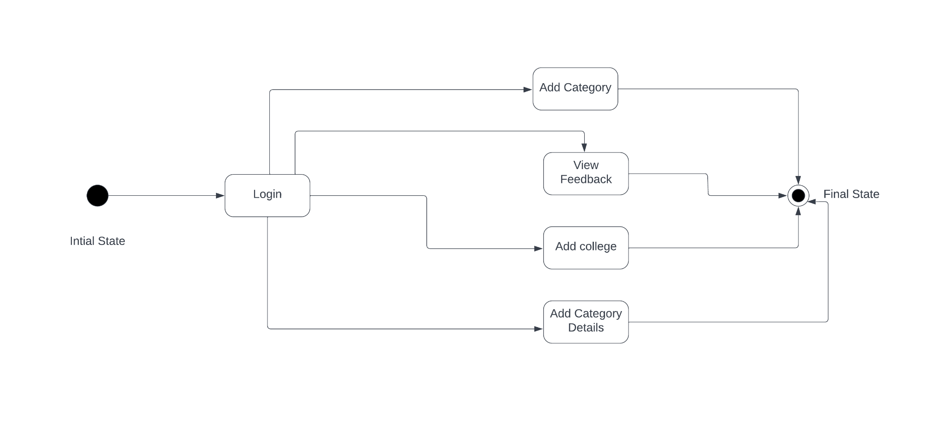
State Diagram
For Administrator

Slide 14
Data Flow Diagram
Level 0
User
Geolocational Analysis
Views Map

Slide 15
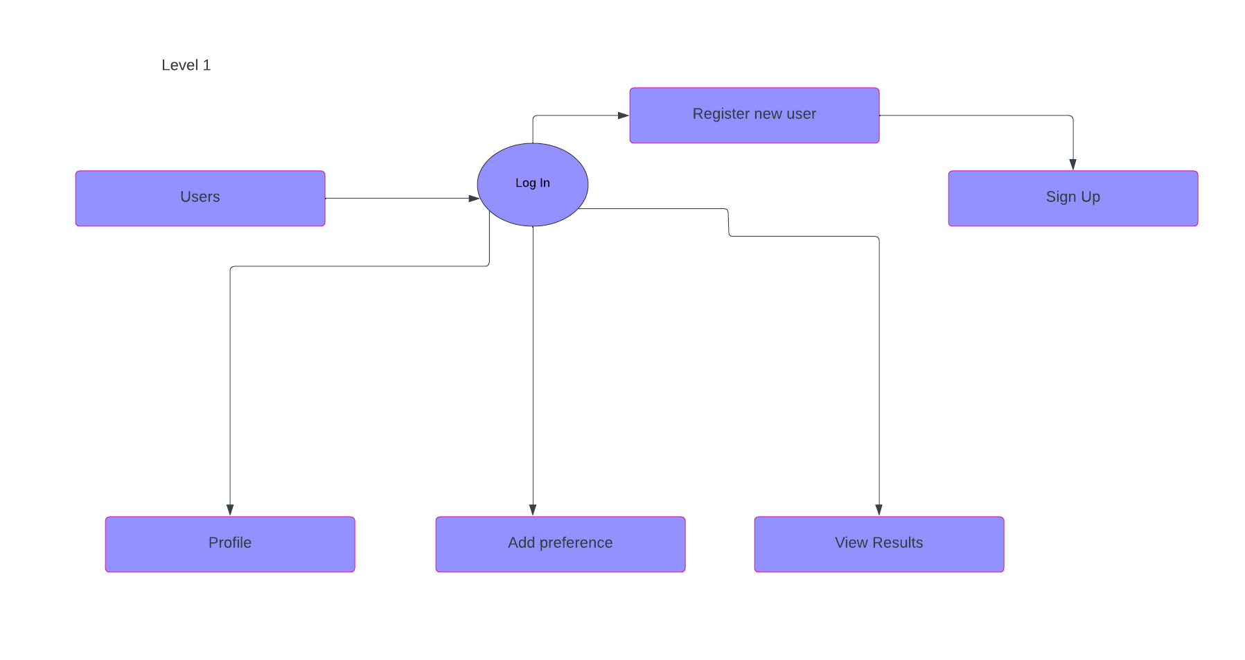

Slide 16
Methodology
Working of the System
The product will have an admin and a user interface.
The data will be plotted based on the user’s interest.
The user preferred dataset is further classified into different classes based on certain class features.

Slide 17
Concepts and Technologies used:
GPS
The use of GPS technology to pinpoint the locations on the map
KNN algorithm
This algorithm is used to group closest facility based on their features into their corresponding classes

Slide 18
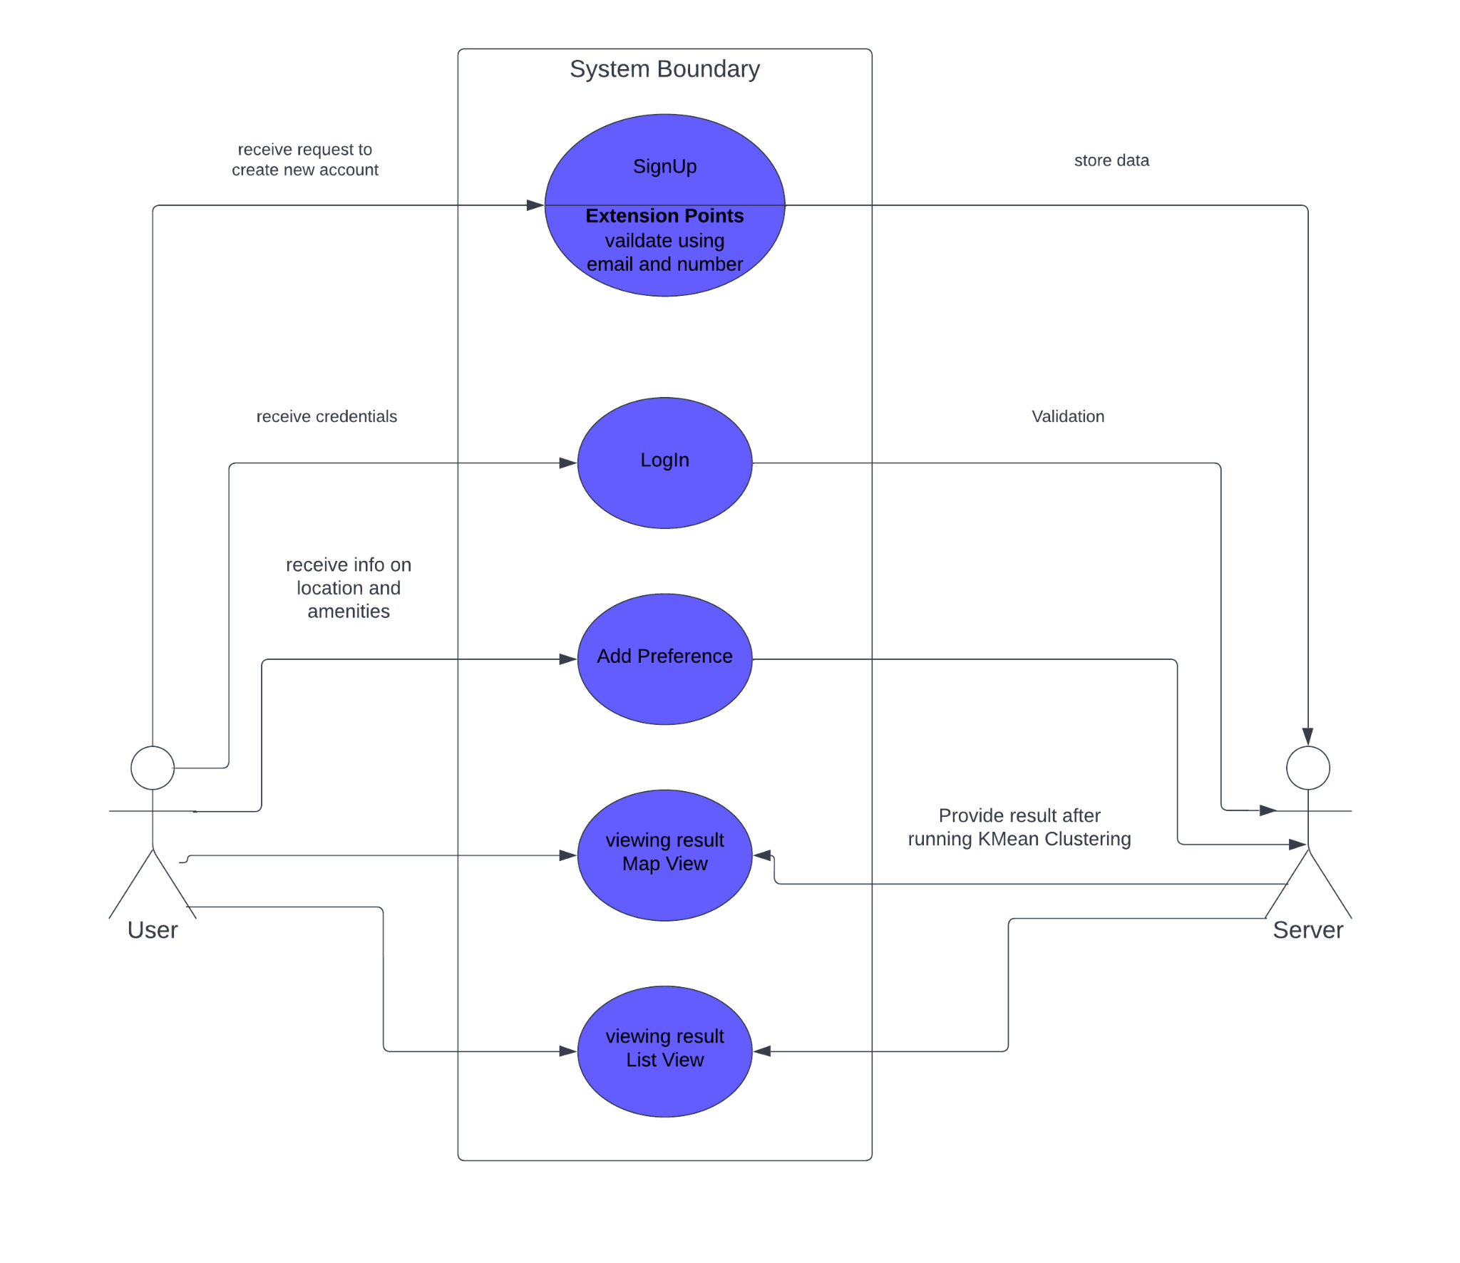
Use Case Diagram

Slide 19
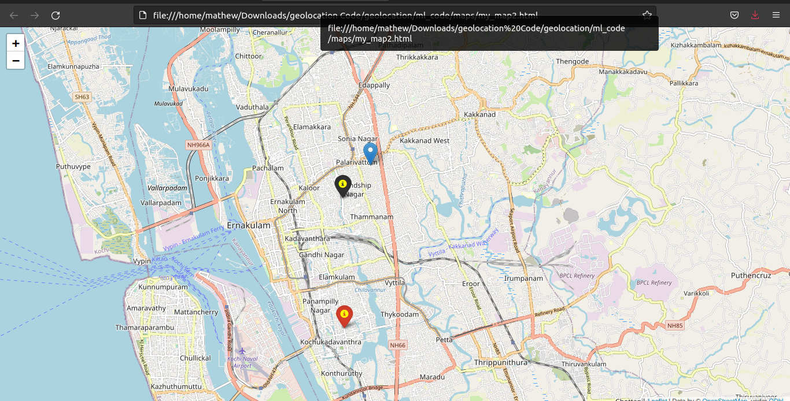
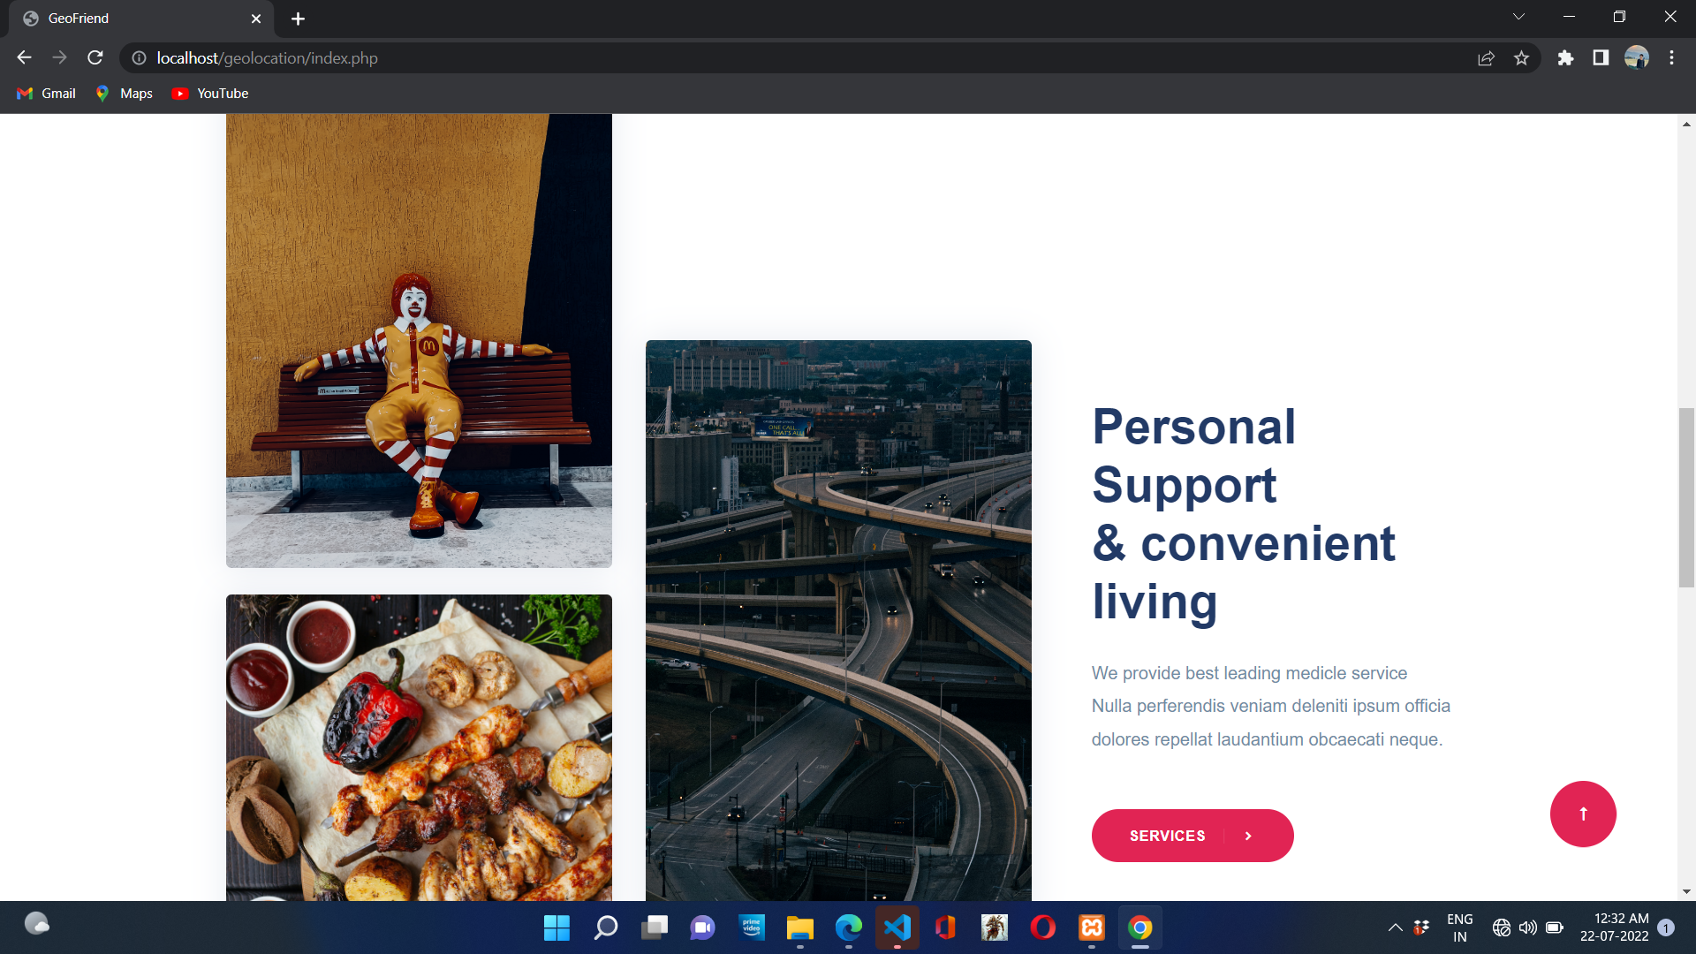
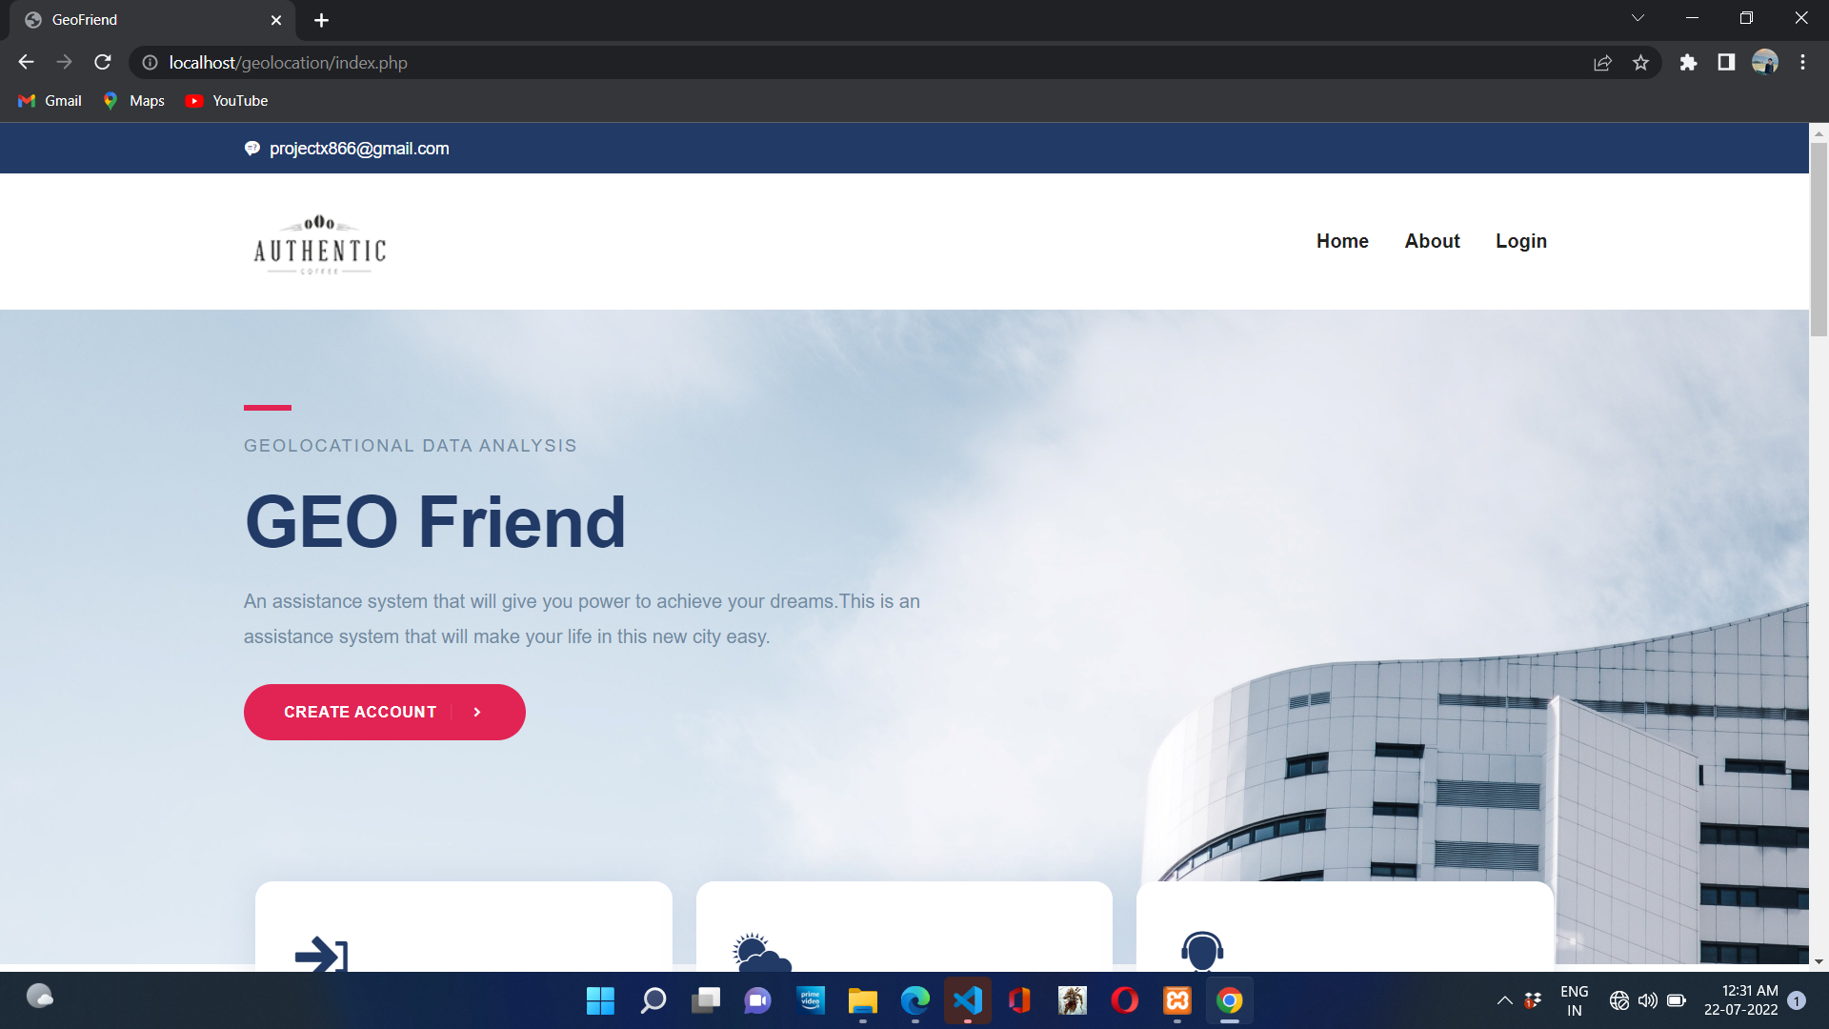
User Interfaces

Slide 20
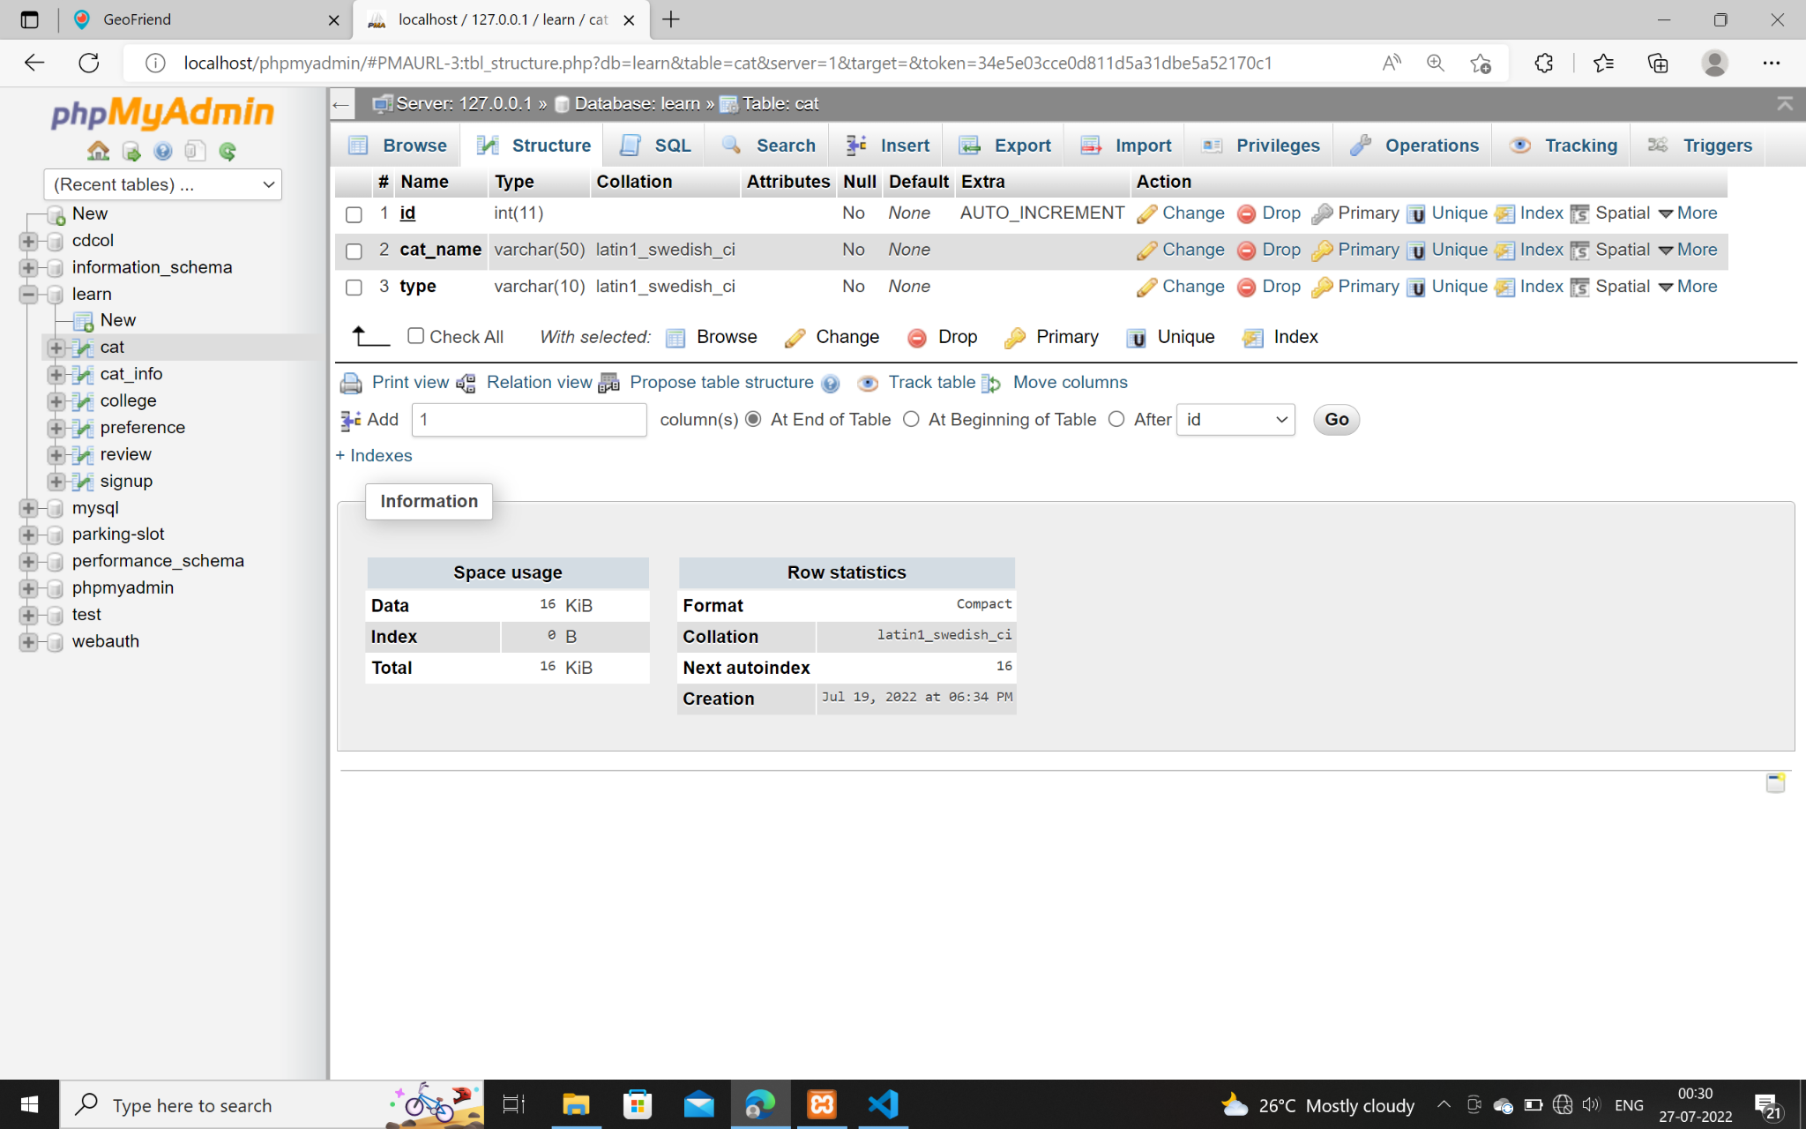
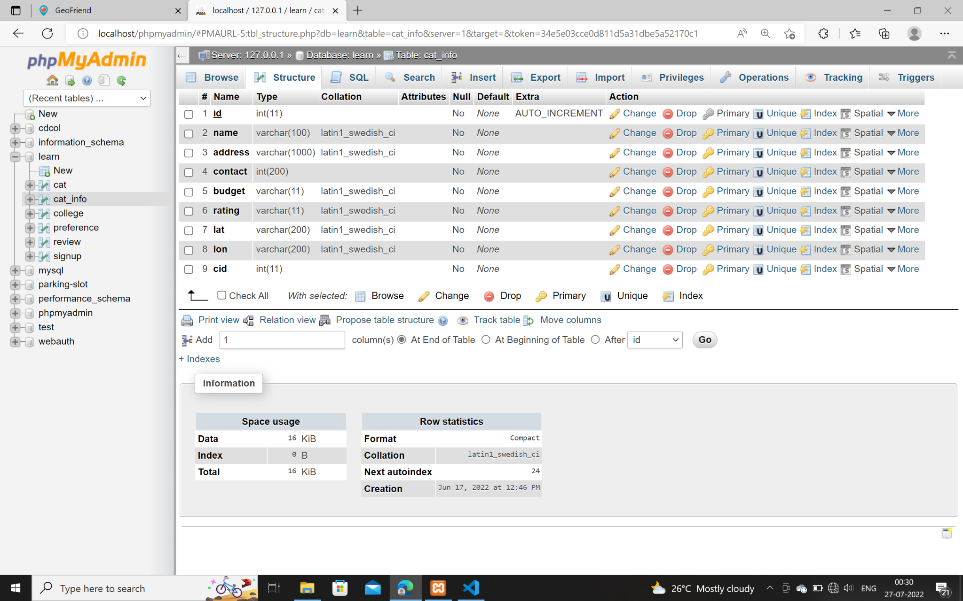
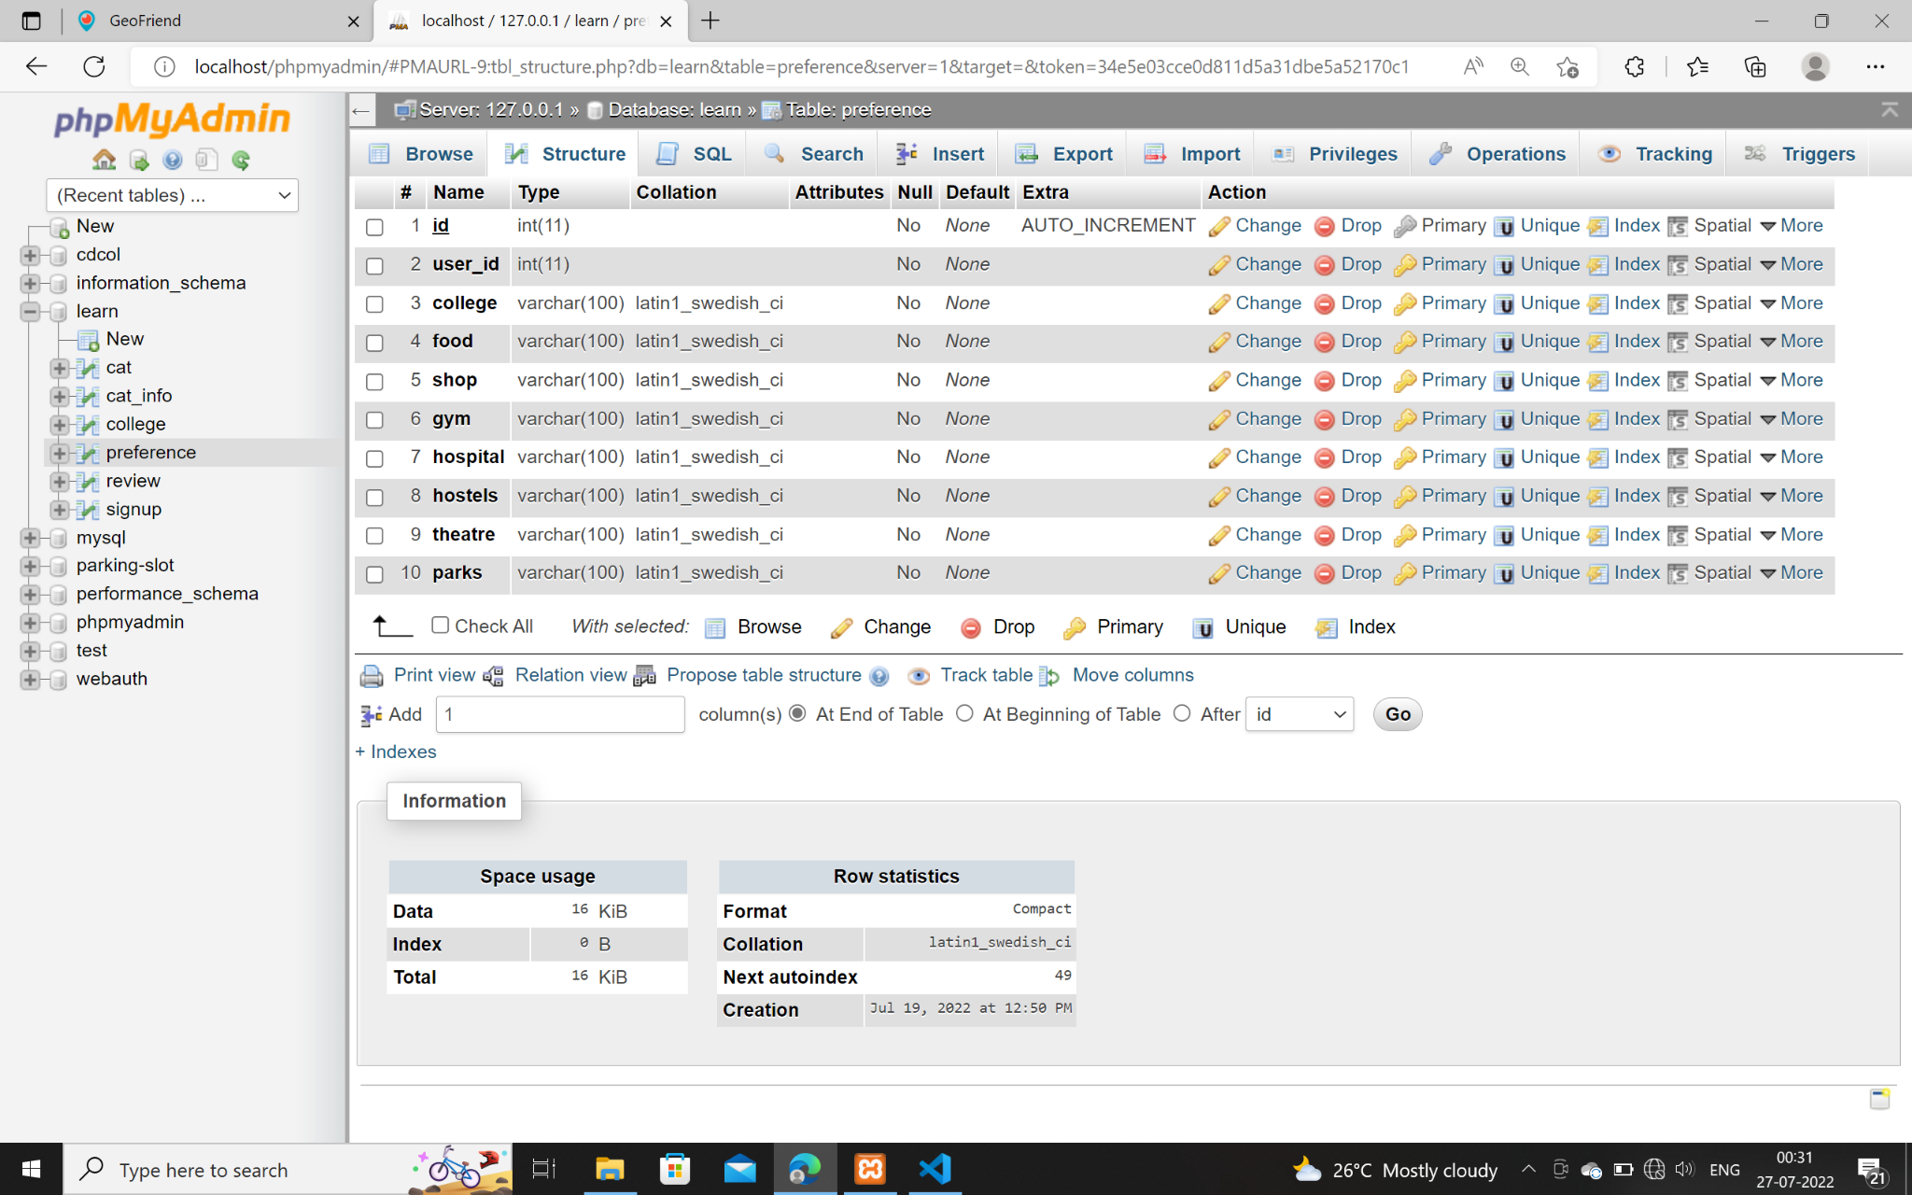
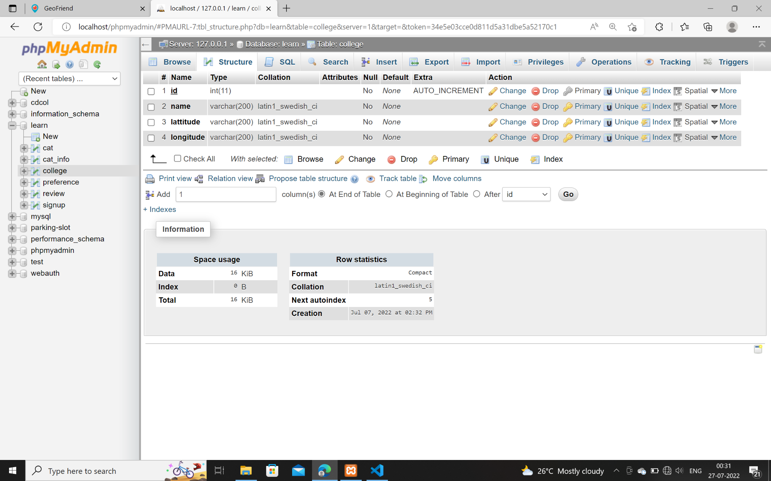
Database

Slide 21
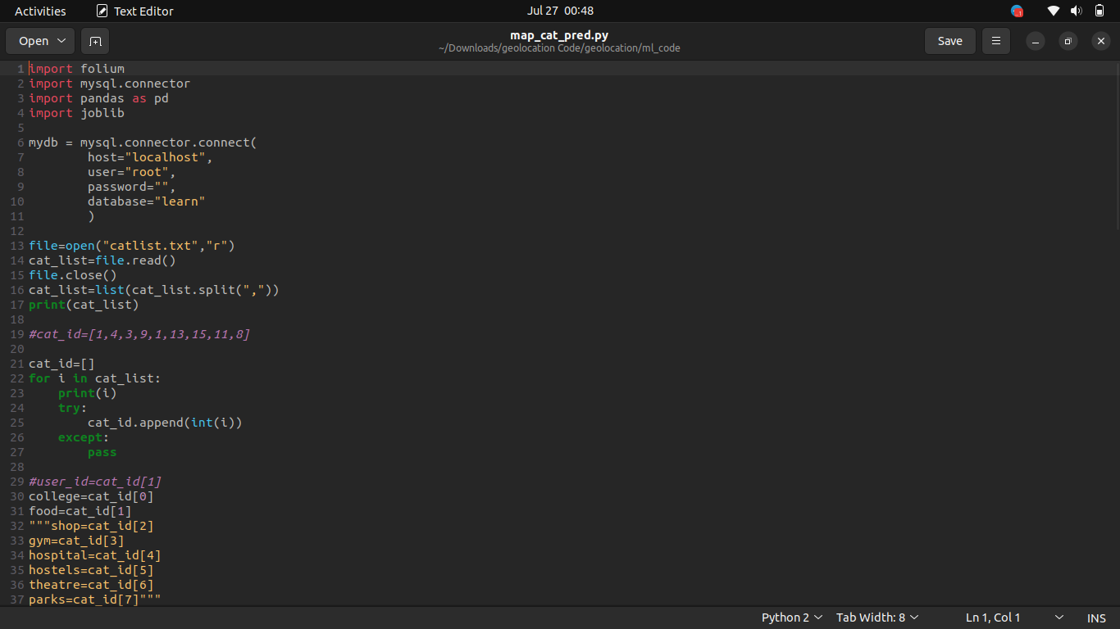
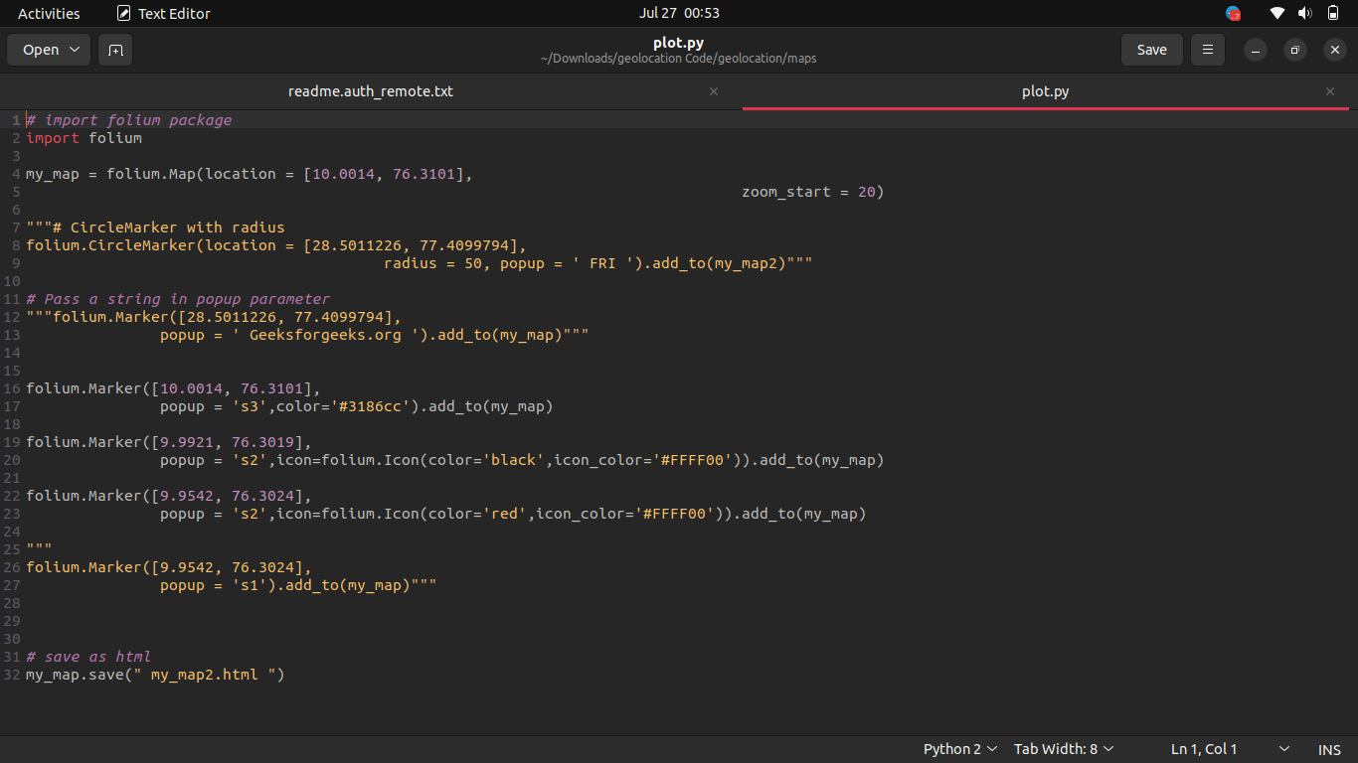
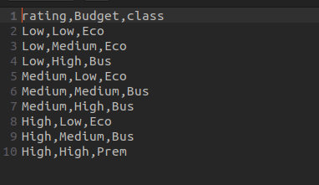
Code Synopsis

Slide 22
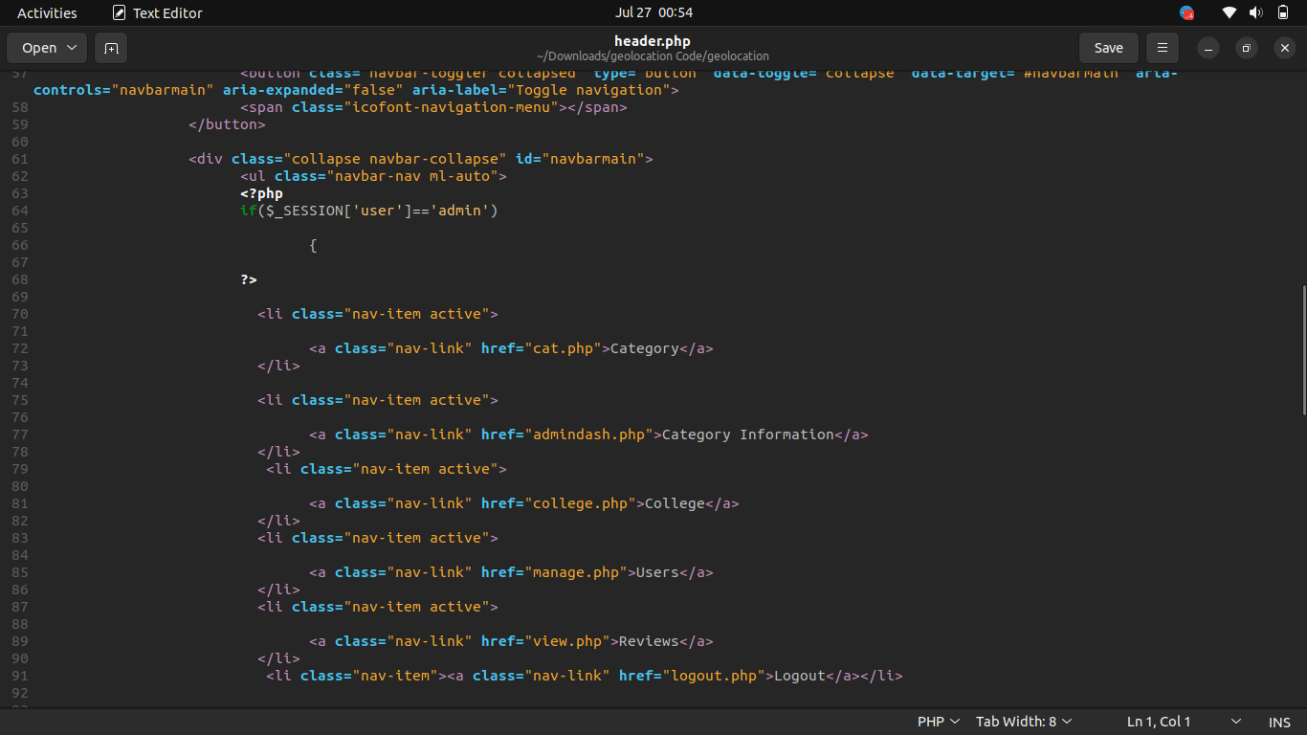
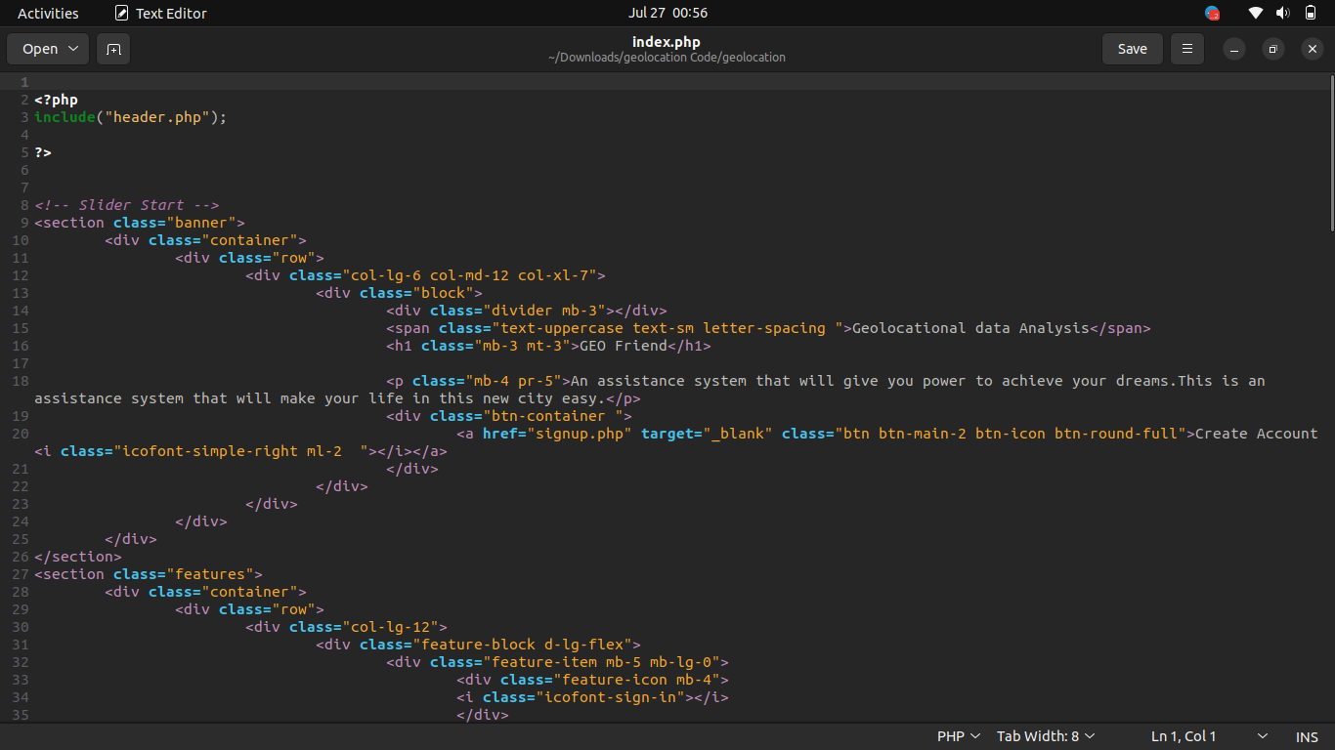
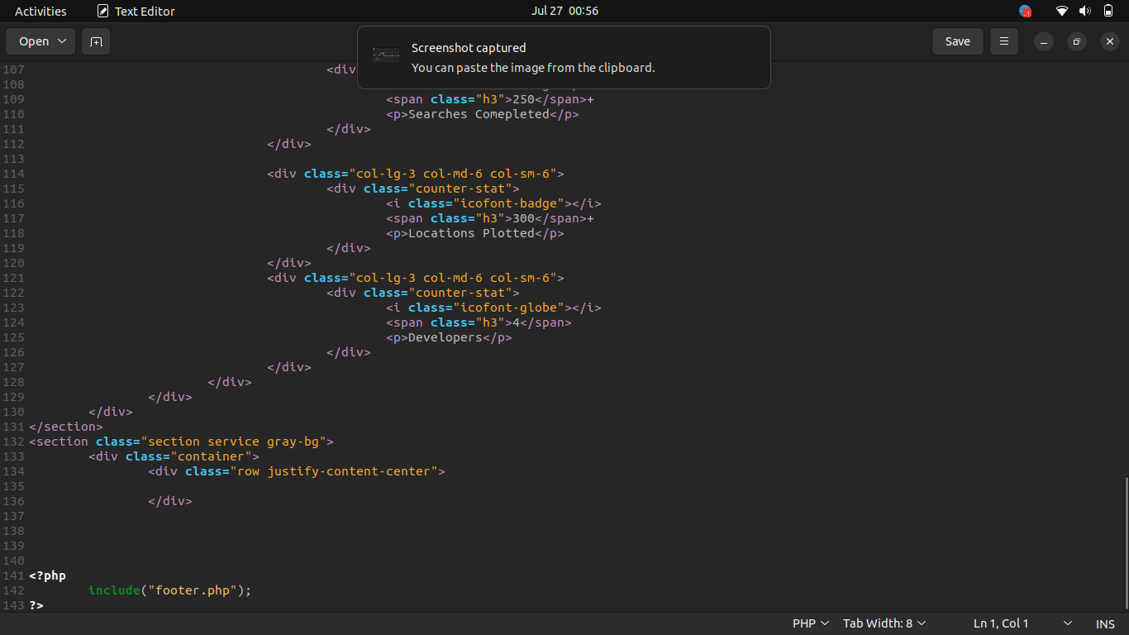
Code Synopsis

Slide 23
Advantages of the Product
The product will save a lot of time for the users.
The product will reduce screen time of users.
The data collected from the users can be further used to predicts the population dynamic of location.
Simple and decluttered user interface.
Fast and convenient

Slide 24
Future of the Product
This is the a initial version of the product, it has a lot of room for improvement. We will improve our system based on the user review and suggestions.
Also we are planning to add the these features in future updates:
Including more communities to our product circle.
Ticket and other booking facilities.
Predicting best activities a user can do under their budget constraint in a city.

Slide 25
Conclusion
We have created an assistance system that will support the users and provide details about the facility of their choice.
This is an assistance system that will make your life in the new city way more easier than ever before.
We have developed both the website and the ML part of the product, and the integration part is only remaining work to be done.
The locational data is collected from user with proper and full consent from the user, and all the data provided by the user will be kept confidential.

Slide 26
Thank You

